Slide 1
“Really Quick Tips, Tricks & Necessary Things.”
Cynthia Campbell
Coastal Georgia Comprehensive Academy
Savannah, Georgia
Cynthia.Campbell@sccpss.com

Slide 2
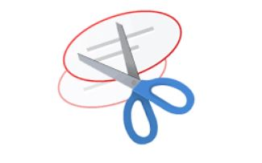
Snipping Tool

Slide 4
IPEVO
Check IPEVO every month for a new Wishpool Offer!

Slide 5
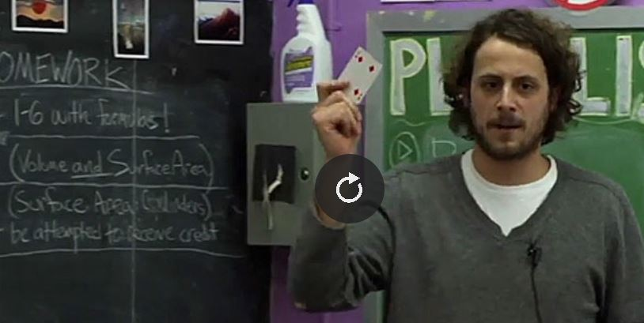
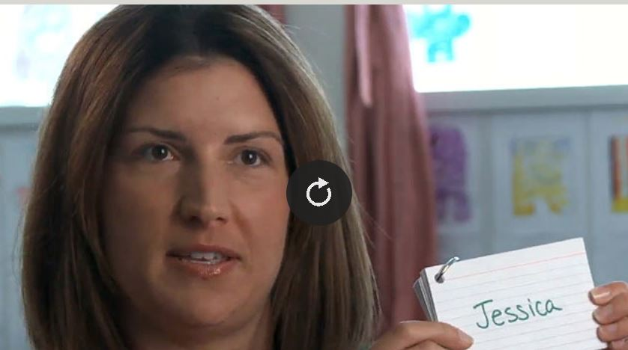
Student Participation
Card-o-Matic
Playing Card Participation

Slide 6
AUDIENCE PARTICIPATION SLIDE!

Slide 7
STEM For All

Slide 10
Hundreds of articles to help you better understand giftedness.

Slide 11
$15,514 in Donations – 25 Projects since 2010

Slide 12
Indoor Recess, Mindfulness Exercises, Dance Routines and more

Slide 13
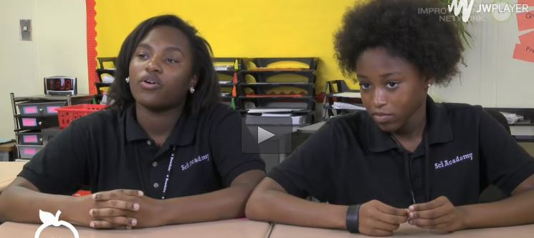
Non Verbal Praise Routines

Slide 14
The current password is “object”

Slide 16
Get your School Code from your Media Specialist

Slide 17
Critical Thinking Required! Math Lessons

Slide 19
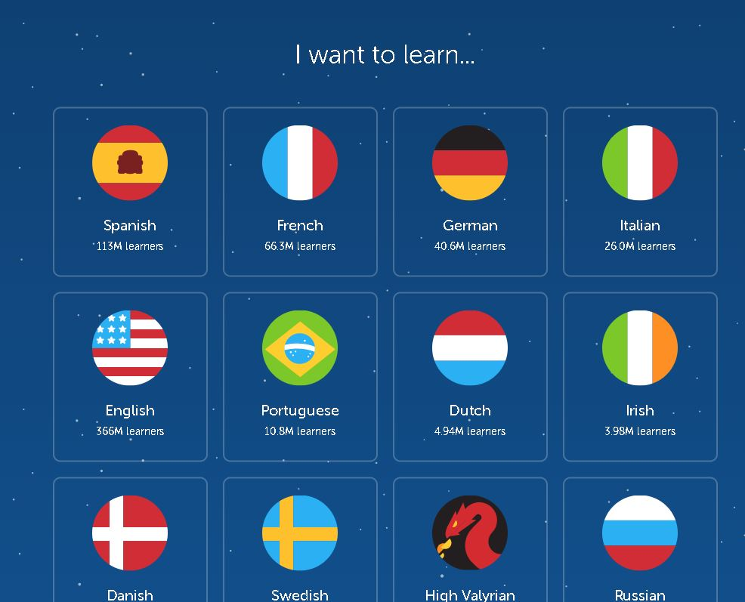
Duolingo

Slide 20
Tip & Tricks

Slide 23
Create Your Own Websites!

Slide 24
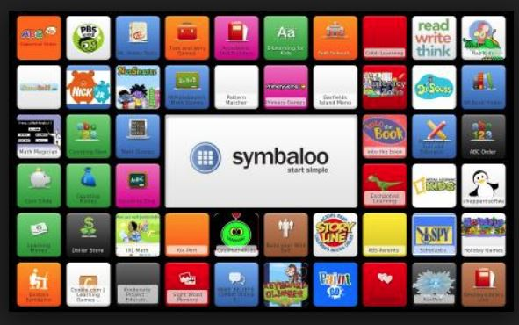
Organize and Individualize with Symbaloo

Slide 25
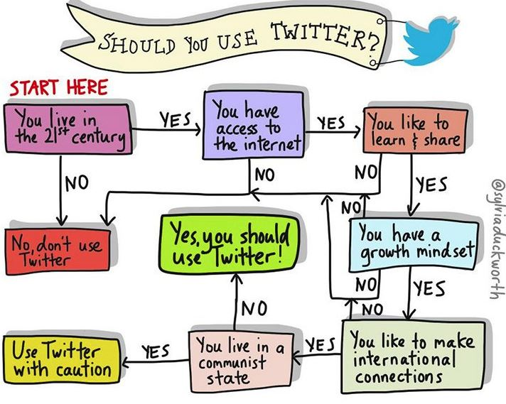
Build your Personal Learning Network (PLN)

Slide 26
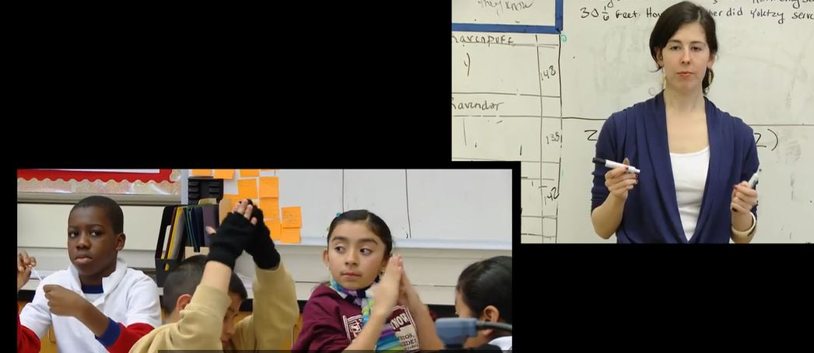
Communicate Learning with
Silent Signals

Slide 27
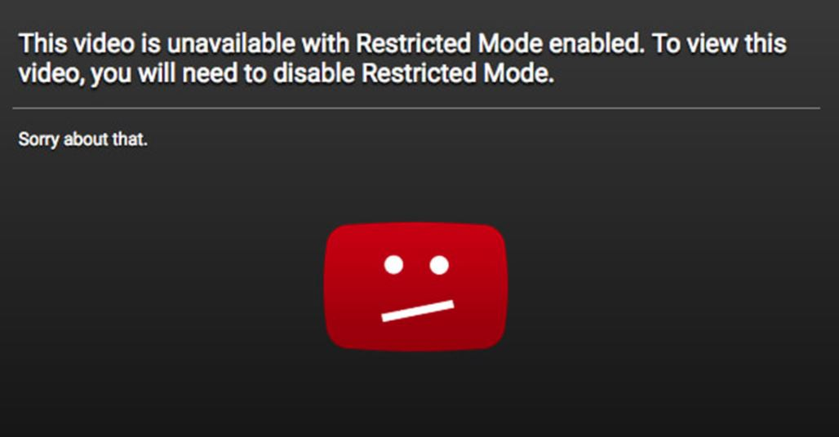
Sign into your SCCPSS Google Account to gain access to restricted videos!

Slide 28
Free Stuff in the Mail!

Slide 29
Free Stuff in the Mail!

Slide 30
Free Stuff in the Mail!

Slide 31
Free Stuff in the Mail!

Slide 32
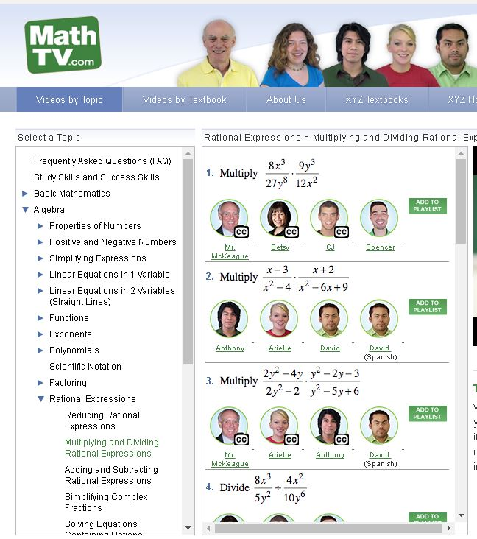
I NEED A MATH TUTOR!
Use in class to teach these skills
Strengthen your skills to improve your teaching
Homework Help for students

Slide 33
Music Fun & Learning

Slide 34
Read Alouds

Slide 35
Teach With Video

Slide 36
Edit Photos, Add Text, Make Collages

Slide 37
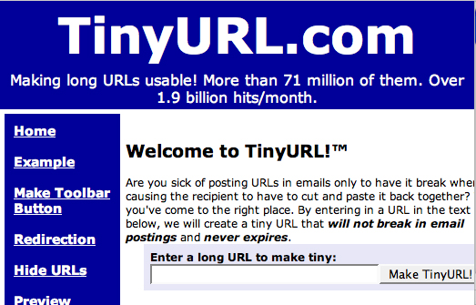

Slide 38
Teacher Blogs – the very best information

